Slide 1
Part Change Notification
SEBN Requirements
Katarzyna Urbaniak, Agnieszka Dzikowska
SCM, SEBN PL
January 2024
SCM-W-470 Rev. 2 Attachment 1 Part Change Notification SEBN Requirements

Slide 2
Content
1. About SEBN
2. Process and content
3. Reason why we need this information in advance
4. SEBN PCN flow chart
5. Documenting PCNs: Mandatory information for VW and MB
6. End of life PCNs (EOL)
SCM-W-470 Rev. 2 Attachment 1 Part Change Notification SEBN Requirements

Slide 3

About SEBN
Sumitomo Electric Bordnetze is a global supplier of electrical wire harnesses and components employing over 39,000 people at more than 41 sites in 14 countries.
For over 30 years we have been closely collaborating with our customers to develop complex wire harness systems up to series production and accompany demanding vehicle projects all the way from initial conception through production to the sequence-specific delivery of our products to the customer.
SCM-W-470 Rev. 2 Attachment 1 Part Change Notification SEBN Requirements

Slide 4
Process and Content
Send information about PCN, only when this change concerns SEBN
BMG (if the change requires it)
SEBN part number / OEM part number which is concerned
Supplier part number which is concerned
Reason of change
Initiator of change
Detailed description of the change (if available drawing or project plan)
Availability of samples
First delivery schedule and marking (e.g. next index, marked packaging)
In case of technical changes send your notification 6 month before first shipment,
all other cases 3 months before first shipment
SCM-W-470 Rev. 2 Attachment 1 Part Change Notification SEBN Requirements

Slide 5

Check also our main requirements at our SEBN website: https://www.sebn.com/supplier-area/
SCM-W-470 Rev. 2 Attachment 1 Part Change Notification SEBN Requirements

Slide 6






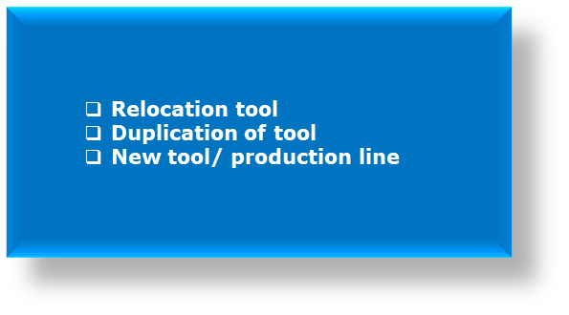
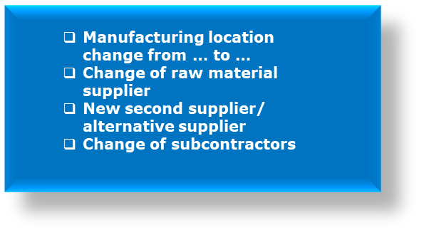
Process and content
PCN type defining the requirements of the basic documentation to start the PCN process
A: Change to product
The required technical engineering approval „BMG” / Development Release was provide
The required technical engineering approval „BMG” / Development Release was provide
BMG / Development Release
LSA
QMS Certification
OEM site qualification in acc. VDA 6.3 / Formel Q
SCM-W-470 Rev. 2 Attachment 1 Part Change Notification SEBN Requirements

Slide 7

Process and content
PCN type defining the requirements of the basic documentation to start the PCN process
D: Logistic
E: Documentation change
Packagging change
Pallete size
Minimum order quantity
Change of drawing description / without fit form function change
Internal documentation concerning tools /processing specification
*In supply chain of ZSB parts, the supplier is obliged to present a new PPA proposal regarding documentation including Master package for the ZSB parts at SEBN
SCM-W-470 Rev. 2 Attachment 1 Part Change Notification SEBN Requirements

Slide 8
Reason why we need this information in advance
We have to check our production line:
✓ crimping
✓ US welding
✓ connecting
✓ testing
✓ handling
✓ IMDS/REACH/ROHS
✓ In worst case we need new test modules
For example:
› The camera system must detect the relay type and designation
› Camera system detects new fuse type and fuse from new manufacturer
SCM-W-470 Rev. 2 Attachment 1 Part Change Notification SEBN Requirements

Slide 9

SEBN PCN flow chart
Supplier sending PCN to PCN@sebn.com
Communication with supplier
Checking of information by SEBN PCN Team
no
Information is not completed
Information is complete
yes
A: Change to product
B: Change to product process
C: Change to supply chain
D: Logistic
E: Documentation change
Distribution of all information to affected SEBN locations
Affected SEBN location requests the PPA documentation from supplier
Submission of PPA documentation to SEBN / including samples
Release of PPA process
SCM-W-470 Rev. 2 Attachment 1 Part Change Notification SEBN Requirements

Slide 10
Use of SEBN PCN distribution file for VW and MB
Part Change Notification
https://www.sebn.com/supplier-area/
Supplier Name:
Mandatory information
MB / VW part no | SEBN part no | Description of the change | Reason of the change | Initiator of change | Availability Development Relais / BMG (if required) | Availability of samples (if required) | First ship date | Last date for mixed shipment | Last order date of the old version/part | Identification of boxes for first shipment | Has the OEM been informed of the change?
SCM-W-470 Rev. 2 Attachment 1 Part Change Notification SEBN Requirements

Slide 11
All necessary information about PCN you can find on the following page https://www.sebn.com/supplier-area/
SCM-W-470 Rev. 2 Attachment 1 Part Change Notification SEBN Requirements

Slide 12
Our values

